Slide 1
C&I Hybrid Cooling Grid Forming ESS
Safety Constraints V1.0
2025/04
Security Level:

Slide 2
1. Version information
1. Version history information
Version No. | Major Drafting Expert | Major Review Experts | Revisions
V1.0 | Chen Mingshu 00648641 | Zhou Kui 00921646、Guo Lei 00867149、Cheng Ke 00642757、Pi Zhiwu 00832017、Ma Wei 00635077 | V1.0 Initial release of the trial version
Notes:
阻抗检测@>100 kΩ

Slide 3

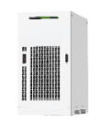
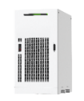

2. Scenario Description and Diagram
Typical Scenario 1: PV+ESS low-voltage on-grid
Scenario constraints:
Applies to the scenario where a single SmartLogger and a single grid connection point are used. A maximum of 20 ESSs and 30 PV inverters (V3-C/M3/V5/V5+/V6 series inverters) are supported. PV inverters of different models can be used together.
The V3-C/M3/V5/V5+/V6 inverters can be connected in parallel with the ESS and support 2s backflow prevention.
If the 215 kWh, 161 kWh, and 107 kWh ESSs can be connected to the same SmartLogger, the energy priority mode and power priority mode can be selected;Mixed use is not supported in frequency modulation scenarios.
Working mode: In the PV+ESS scenario, the ESS can work in maximum self-consumption, TOU, TOU-without meter (TOU, fixed power), charge/discharge based on dispatch, peak shaving, or power boost mode.
Auxiliary power: Independent mains is the first choice for the auxiliary power supply of ESSs. For the 380 V, 400 V, or 415 V power grid, the auxiliary power can be obtained from phase C of the PCS outlet. An auxiliary transformer is required for the IT system and 420/440/480 V power grid.
Loads
RS485/MBUS
400 V AC
PV modules
V3/V5/V5PLUS/V6
RS485/MBUS
400 V AC
Optimizer
M3/V6
Metering point of grid company
Smart Power Sensor
400 V AC
Step-up transformer
400 V/10 kV
Capacity charge is based on transformer capacity.
220 V AC
RS485
FE/Optical fiber
.
x 20
.
SmartLogger3000
ESS
FE/Optical fiber
The following uses the low-voltage on-grid PV+ESS system as an example. For other grid-tied scenarios, see the solution technical documentation.
Notes:
阻抗检测@>100 kΩ

Slide 4


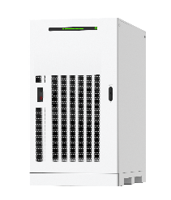


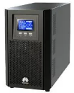
2. Scenario Description and Diagram
Typical scenario 2: Low-voltage seamed on/off-grid switching
Scenario constraints:
1. When the SmartLogger functions as the on/off-grid controller, it is not recommended that the SmartLogger send scheduling commands to northbound devices. Only the application scenario with a single grid connection point and a single SmartLogger is supported.
2. Only low-voltage coupling is supported. Medium-voltage coupling is not supported. Number of ESSs in parallel: ≤ 20; Manual/automatic on/off-grid switchover with seams: 3s for a single ESS and 10s for multiple ESSs;
3. In the seam on/off-grid switching scenario, the PV-to-ESS ratio is less than 2:1.
4. In VSG mode, the SOC of the ESS is between 10% and 90%.
5. Generally, genset is not configured in the seamed on/off-grid switching scenario. If the genset is available, the genset shall be connected to loads using the ATS. The ATS switching delay shall be increased by more than 30s to reduce the PV+ESS seamed switching time. Otherwise, the ATS may be triggered or the genset may be started or stopped.
6. UPS requirements: power ≥ 1 kVA, online UPS, 220 V AC, backup time ≥ 1 hour (If the off-grid operation lasts for a long time, the UPS backup time shall be greater than 48 hours.)
PV modules
SmartPVMS
Optimizer
Inverter
Power distribution facility
On/Off-grid
switch
Smart Power
Sensor
400 V AC
Utility power grid
.
x 20
.
.
ATS
Genset
Critical loads
Common loads
ESSs
UPS
SmartLogger
The following uses seamed on/off-grid switching scenario as an example. For details about other scenarios, see the solution technical documentation.
Notes:
阻抗检测@>100 kΩ

Slide 5
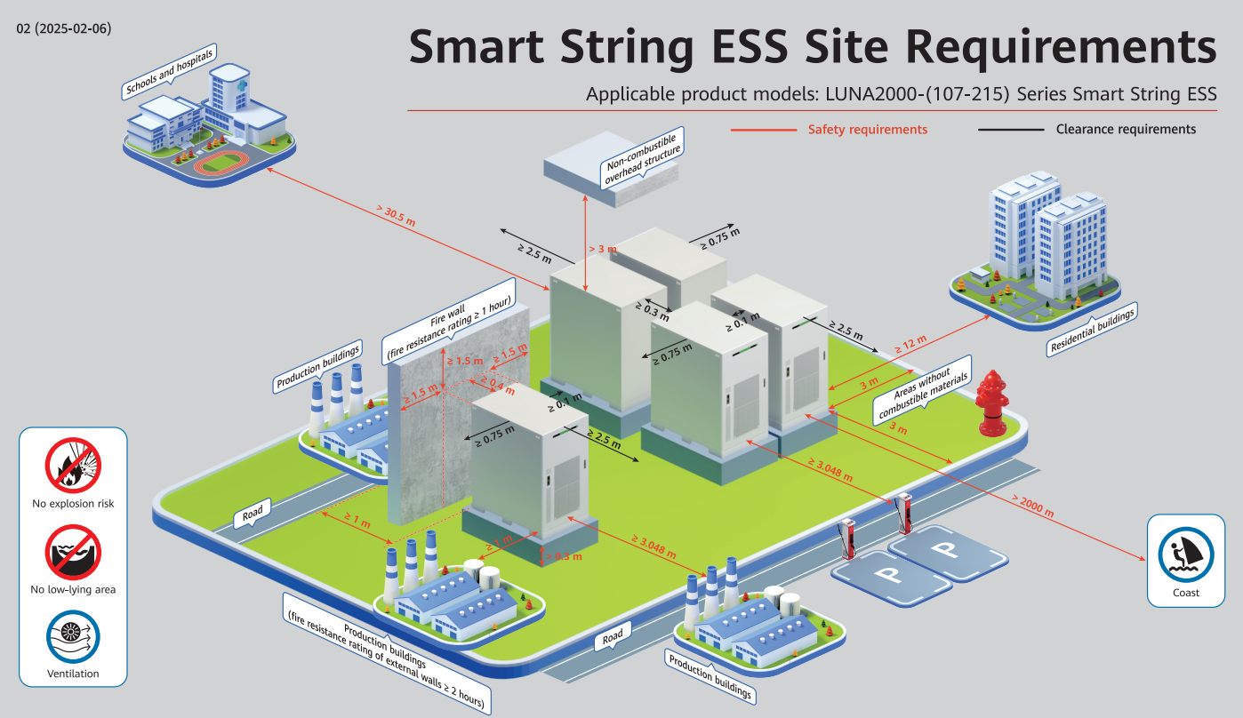
3. C&I Hybrid Cooling Grid Forming ESS Site Requirements
Notes:
阻抗检测@>100 kΩ

Slide 6
4. C&I Hybrid Cooling Grid Forming ESS safety constraints
Classifieds | Subitem | Detailed Constraints
Site Selection Requirements | Deployment Environment | The ESS can be installed only outdoors and do not install the ESS indoors.
 | 部署环境 | The energy storage system or power station must be installed in a well-ventilated environment without explosion risks. Avoid low-lying environment.
 |  | There must be no combustible materials within 3 m of the ESS or the site to prevent fire from spreading. (Exemption: Single specimens of trees, shrubbery, or cultivated ground cover such as green grass, ivy, succulents, or similar plants used as ground covers shall be permitted to be exempt provided that they do not form a means of readily transmitting fire.)
 |  | Transportation to the site shall be convenient and fire suppression facilities shall be reliable.
 | Top Requirements | You are advised not to add any overhead structure above the ESS. If an overhead structure is necessary in special scenarios, the following conditions must be met: The distance between the overhead structure and the top of the ESS shall be >3 m. The overhead structure shall be non-combustible. If the overhead structure may be damaged in extreme cases, the Company shall not be liable for any damage to the overhead structure.
 | Safe Distance | The distance between the ESS and residential buildings must be >=12 m, and the distance between the ESS and densely populated buildings such as schools and hospitals must be >30.5 m. If the distance does not meet the requirement, fire walls shall be installed between the ESS and the buildings.
 |  | The safety distances between the ESS and buildings shall comply with local fire protection regulations or standards
 | 周边距离 | The ESS located outdoors must be at least 10 ft (3.048 m) away from lot lines, public ways, buildings, combustible materials, hazardous materials, high-piled stock, parking spaces, and other exposure hazards not associated with electrical grid infrastructure. If either of the following conditions is met, the distance between the ESS and the production building shall be permitted to be reduced to 3.28 ft (1 m). In addition, clearance requirements for equipment transportation, installation, and maintenance shall be considered. There are 1-hour freestanding fire walls, extending 5 ft (1.5 m) above and extending 5 ft (1.5 m) beyond the physical boundary of the ESS installation. Non-combustible exterior walls with no openings or combustible overhangs are provided on the walls adjacent to the ESS and the fire resistance rating of the exterior walls complies with 2-hour fire resistance rating of ASTM E119 or UL 263. The distance between the exhaust device of an ESS and the heating and ventilation vents, air intake vents of air conditioners, windows, doors, unloading platforms, and fire sources of other buildings or facilities must be >=4.6 m.
 | Salt fog and pollution requirements | The ESS shall not be installed in salt-affected or polluted areas because this will cause corrosion. The ESS shall be used in the following or better environments: Outdoor environment >2000 m away from the coast. You are advised not to use the ESS in an area within 2000 m of the coast. (If you need to use it, confirm with the vendor or the Company's engineers.) More than 3000 m away from heavy pollution sources such as smelteries, coal mines, and thermal power plants More than 2000 m away from medium pollution sources such as chemical, rubber, and electroplating industries More than 1000 m away from light pollution sources such as packing houses, tanneries, boiler rooms, slaughterhouses, landfill sites, and sewage treatment plants
 | Anti-break-in | Security fencing: It is recommended that physical walls or fences be used for isolation and protection in the energy storage equipment area. The fences shall be equipped with a door lock and the recommended fence height is >2.2 m. Fire walls shall be permitted to be substituted for part or all of the fences, depending on the actual design plans.
Notes:
阻抗检测@>100 kΩ

Slide 7
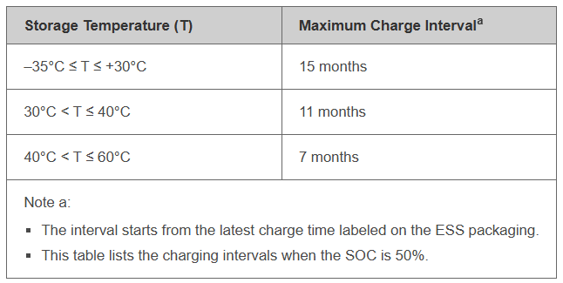
4. C&I Hybrid Cooling Grid Forming ESS safety constraints
Classifieds | Subitem | Detailed Constraints
Foundation Requirements | load bearing | The cabinet installation dimensions and load-bearing capacity requirements are met.
 | draining | Meet the local historical maximum rainfall drainage requirements.
 | heights | The foundation must be higher than the local historical maximum water level and at least 300 mm above the level ground.
 | flattened | The horizontal error of the contact surface between the equipment foundation and the cabinet is <=3 mm.
其他要求 | Storage charging | You are advised to use the ESS in a timely manner. If the ESS is stored for a long time or is not running, recharge the power periodically. Otherwise, the ESS may be damaged. The following table lists the maximum charge intervals. Charge the ESS promptly and calibrate the SOC to 50%.
 | Insulation protection | Tools meet the insulation level and protection requirements.
 | Commissioning | Fire Extinguishing Before Installation and Commissioning
 | People | The personnel qualification meets the requirements of local laws and standards.
Remarks: The Safety Constraints on Smart PV C&I ESS V2.0 is released this time. The R&D department will update this document based on the progress of the ESS industry and related research results.
Notes:
阻抗检测@>100 kΩ

